Slide 1
Computer Network
Network Basis

Slide 2
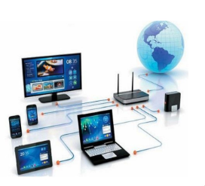
Basics
A network consists of two or more computers that are linked in order to share resources, exchange files, or allow electronic communications.
The computers on a network may be linked through cables, telephone lines, radio waves, satellites, or infrared light beams
Components
Sender
Receiver
Message
Transmission Media

Slide 3
Need for Networking
File Sharing
Resource Sharing
Communication and collaboration
Remote Access
Data protection

Slide 4


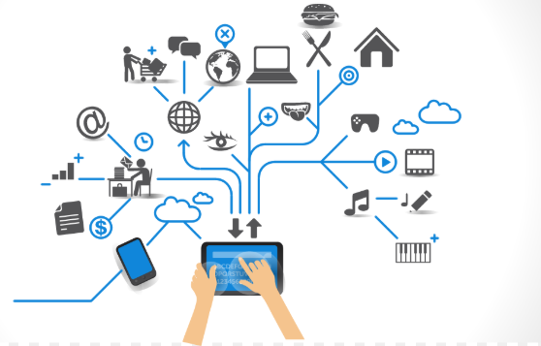
Characteristics
Performance
Security
Reliability

Slide 5



Modes of Communications
Simplex
Data transferred in one direction
Eg-Keyboard
Half Duplex
Data transferred in both direction but one at a time
Eg- Walkie-Talkie
Full Duplex
Data can be Transferred in both direction
Eg- Cell Phone

Slide 6
Topology
Link: https://www.youtube.com/watch?v=F35sSPTahS8
Topology refers to the layout of connected devices on a network. It describes the layout of the wire and devices as well as the paths used by data transmissions.

Slide 7
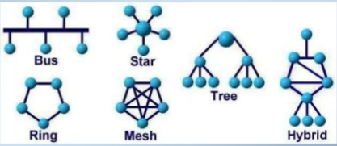
Network Topology
BUS
STAR
RING
HYBRID
Types
TREE
MESH

Slide 8
Mesh Topology
Every device has a point to point link to every other device
Node 1 must be connected with n-1 nodes.
A fully connected mesh can have n(n-1)/2 physical channels to link n devices
It must have n-1 I/O ports.

Slide 9
Mesh Topology (Advantages and Dis advantages)
They use dedicated links so each link can only carry its own data load. So traffic problem can be avoided.
It is robust. If any one link get damaged it cannot affect others.
It gives privacy and security.
(Message travels along a dedicated link)
Fault identification and fault isolation are easy.
The amount of cabling and the number of I/O ports required is very large.
The sheer bulk of wiring is larger then the available space
Hardware required to connect each device is highly expensive.

Slide 10
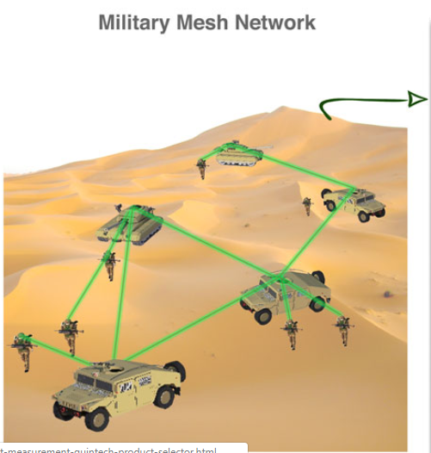
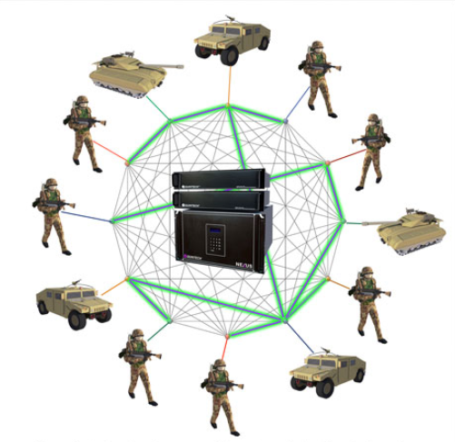
Mesh Topology
Applications
Telephone Regional Office
WAN(Wide Area Network)
Military Mesh Network
https://www.quintechelectronics.com/-mobile-/responsive/html/2016/applications/new-military-mesh-test-bed.html

Slide 11
Star Topology
Each device has a dedicated point-to-point link to the central controller called “Hub”(Act as a Exchange).
There is no direct traffic between devices.
The transmission occurs only through the central “hub”.
When device 1 wants to send data to device 2; First sends the data to hub. Which then relays the data to the other connected device..

Slide 12
Star Topology
Advantages
Less expensive then mesh since each device is connected only to the hub.
Installation and configuration are easy.
Disadvantages
Even it requires less cabling then mesh when compared with other topologies it still large.(Ring or bus)..
Dependency(whole n/w dependent on one single point(hub).When it goes down. The whole system is dead
Less cabling is need then mesh.
Robustness.(if one link fails, only that links is affected. All other links remain active)
Easy fault identification
No disruptions to the network then connecting (or) removing devices

Slide 13
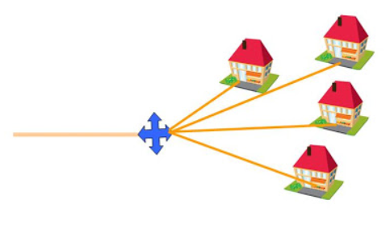
Applications
Star topology used in Local Area Networks(LANs).
High speed LAN often used STAR.
Star topology often used in Home and offices

Slide 14
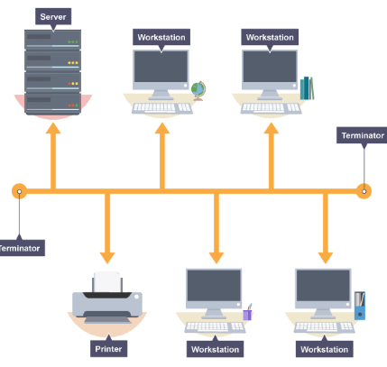
Bus Topology
A bus topology is multipoint. One long cable act as a backbone to link all the devices.
Drop line is the connection b/w the devices and the cable. This allows only one device to transmit at a time.
In bus network, all stations are attached to a single cable.
When a station sends a message, it is broadcast down on the cable in both directions. Terminators at the end of the cable prevent the signal from reflecting back to the sender.
All stations on the cable constantly monitor for messages meant to them. When a station detects a message meant for it, it reads the message from the cable and the other stations will ignore it.
Since all stations are sharing the same cable, some form of control is needed to make sure which station will transmit when, otherwise there will be a collision.

Slide 15


Bus Topology
Advantages:
Ease of installation
Less cabling.
This network can still function if one of the computers malfunctions
Disadvantages:
Difficult reconfiguration and fault isolation.
Difficult to add new devices.
Signal reflection at top can degradation in quality.
Bad connection to the cable can short it and bring down the entire network.

Slide 16
Ring Topology
each device has a dedicated connection with two devices on either side.
The signal is passed in one direction from device to device until it reaches the destination and each device have repeater.
When one device received signals instead of intended another device, its repeater then regenerates the data and passes them
To add or delete a device requires changing only two connections.

Slide 17
Ring Topology
Advantages
Easy to install.
Disadvantages
Unidirectional traffic.
Easy to reconfigure.
Fault identification is easy
Break in a single ring can break entire network.

Slide 18
Ring Topology
Applications
Ring topologies are found in some office buildings or school campuses.
Today high speed LANs made this topology less popular

Slide 19
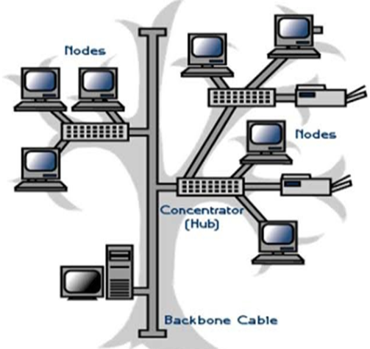
Tree Topology
Also referred to as a star bus topology.
Tree topology is one of the most common network setups that is similar to a bus topology and a star topology.
A tree topology connects multiple star networks to other star networks.

Slide 20
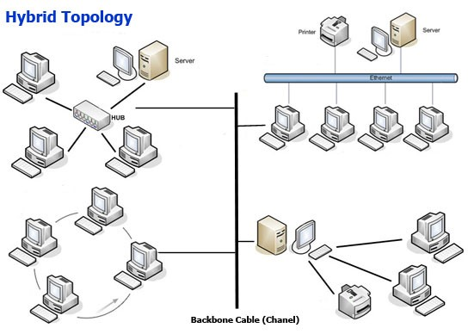
Hybrid Topology
A network which contain all type of physical structure and connected under a single backbone channel.

Slide 21

Considerations for choosing topology
Money
Bus network may be the least expensive way to install a network
Length
Linear bus n/w uses shorter lengths of cable.
Future growth
Star topology, expending a n/w is easily done by adding another devices.
Cable Type
Most common used cable in commercial organization is twisted pair. Which often used with star topologies.
Full mesh topology is theoretically the best since every device is connected to every other device. Next best would be tree topology, which is basically a connection of star.

Slide 22
Problem
Q: For n devices in a n/w, what is the number of cable links required for a mesh, ring, bus and star topology?
Ans:
For n devices network, number of cable links required are
n(n-1)/2 cable link are required for mesh
n for ring
n-1 cable link for bus
n cable link for star topology

Slide 23
Practice Questions
Q1. What is the difference between half-duplex and full-duplex transmission modes?
Q2.Name the four basic network topologies, and cite advantage of each type.
Q3. In each of the following four networks, discuss the consequences if a connection fails.
a. Five devices arranged in a mesh topology,
b. Five devices arranged in a star topology (not counting the hub),
c. Five devices arranged in a bus topology,
d. Five devices arranged in a ring topology.
Q4. When a party makes a local telephone call to another party, is this a point-to-point or multipoint connection? Explain your answer.
Q5. Assume six devices are arranged in a mesh topology. How many cables are needed? How many ports are needed for each device?

Slide 24
Practice Question Solutions
Q1. What is the difference between half-duplex and full-duplex transmission modes?
Ans: In half-duplex mode, each station can both transmit and receive, but not at the same time. When one device is sending, the other can only receive, and vice versa. Like walkie-talkies. In full-duplex mode, both station can transmit and receive simultaneously. Like telephone network.
Q2.Name the four basic network topologies, and cite advantage of each type.
Ans: Bus Topology: Easy installation, less cabling, easy expansation etc.
Ring Topology: Less effort in adding or removing devices, simple fault isolation. Star Topology: Less expensive than mesh, robustness etc. Mesh Topology: Robustness, present of privacy and security.
Q3. In each of the following four networks, discuss the consequences if a connection fails.
a. Five devices arranged in a mesh topology,
Ans: Mesh is high redundancy. Only one device would be disconnected if all the connections were to fail for that device. You can have many connections to other devices thats why its less likely to fail. The only cause for failure at this point is really the power and if you just don't have any. Even if one of the connections between two devices fail there is no effect on network and they can still communicate through other channels.

Slide 25
b. Five devices arranged in a star topology (not counting the hub),
Ans: Star runs to a central device like a switch, so if the switch itself fails then the whole network will be
disconnected. c. Five devices arranged in a bus topology,
Ans: Bus runs in a straight line from one network device to another. So if one gets disconnect then the all the
devices connected down the line get disconnect.
d. Five devices arranged in a ring topology.
Ans. Ring is like a bus except it connects back onto itself. So if one device fails they all fail. The exception is if there is a redundant inside ring like that used in FDDI (fiber ring) then if both get disconnect from one device then they all do.
Q4. When a party makes a local telephone call to another party, is this a point-to-point or multipoint connection? Explain your answer.
Ans: It is Point-to-Point connection because multipoint connection needs more than two end points.

Slide 26
Q5. Assume six devices are arranged in a mesh topology. How many cables are needed? How many ports are needed for each device?
Ans: Cables needed (6*5)/2 = 15 and,
Each device needs to be connected to 5 other devices. So, each device needs to have 5 ports. Six devices times five ports equals 30 total ports.

Slide 27
Solutions
THANKS

